Slide 1
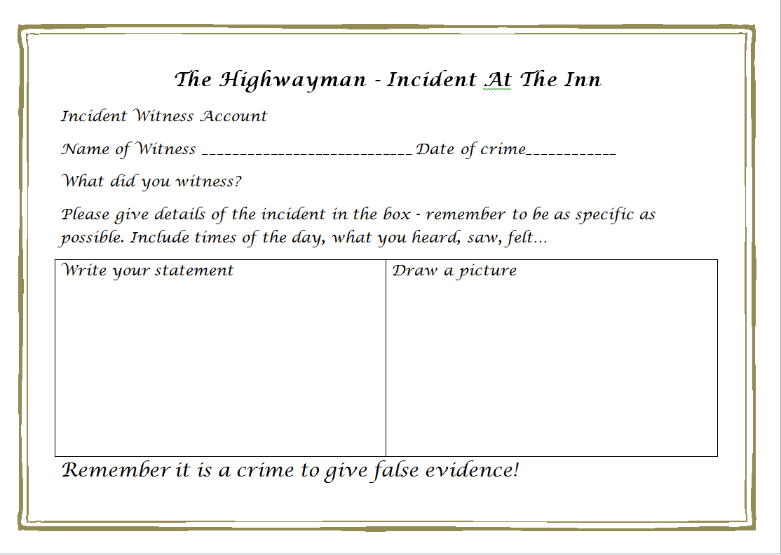
Incident at the Inn
Highwaynan’s Witness Account

Slide 2
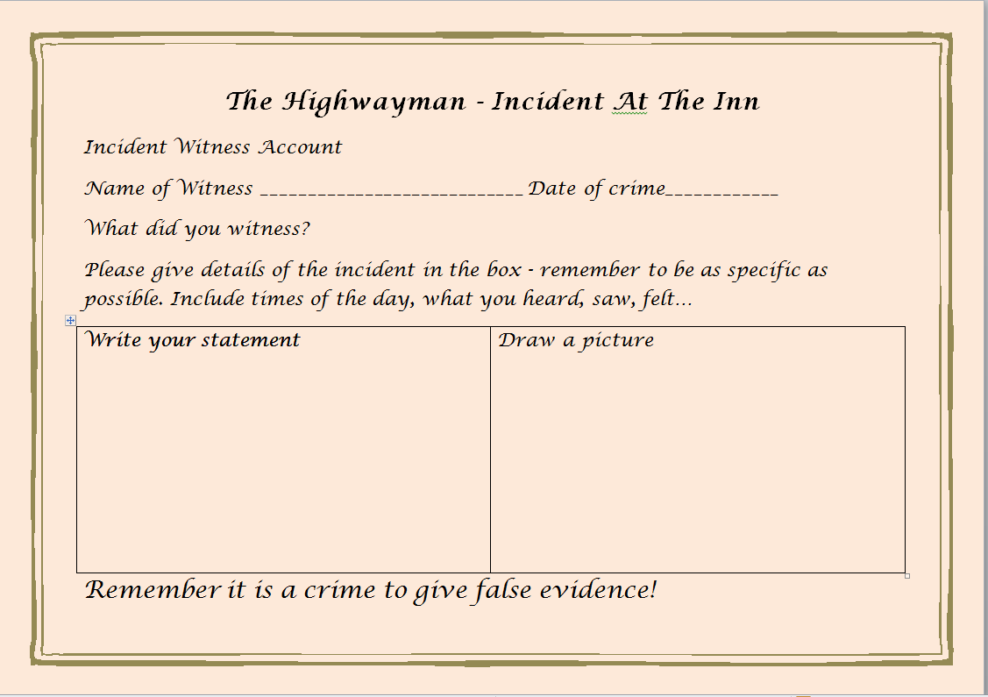
Incident At The Inn
Tim the Ostler’s Witness Account

Slide 3
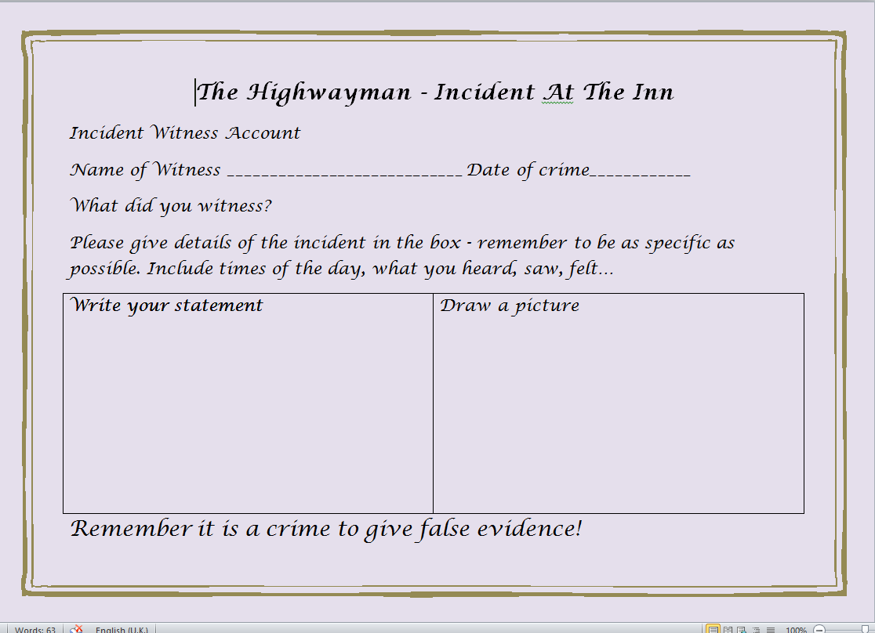
Incident At The Inn
A Kingsman’s Witness Account

Slide 4
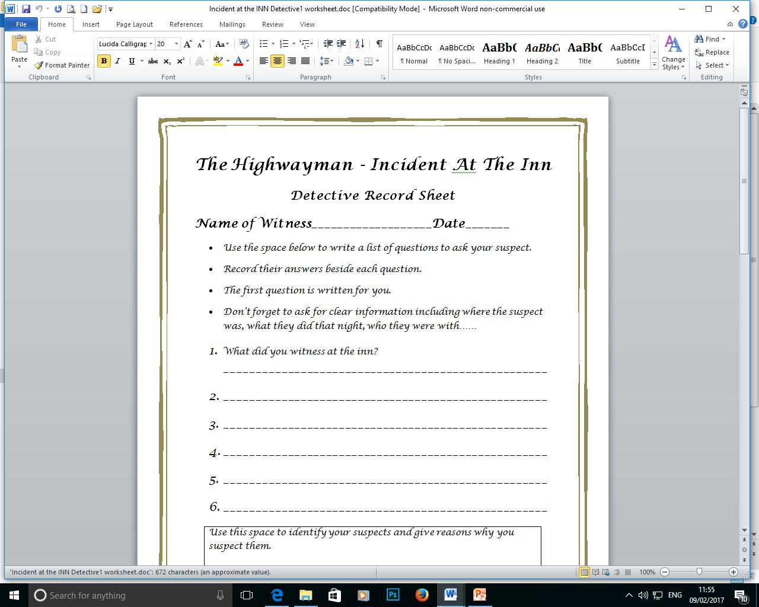
Incident At The Inn
Detective Interview

